Slide 1
Asthma In the Home and Workplace: Risk Factors, Triggers, and Prevention.
Notes:
Version 2.2

Slide 2
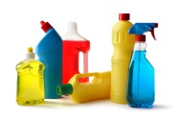
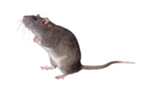


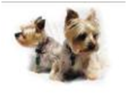
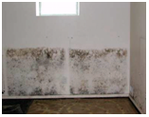

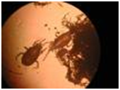
Hazards in the home Asthma Triggers
Chemicals
Mice
Smoke
Cats
Dogs
Mold
Cockroaches
House dust mites

Slide 3
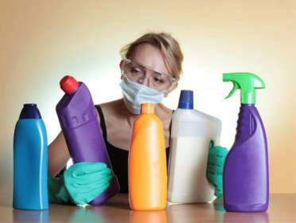
Chemicals, Fragrances, and Sprays

Slide 4
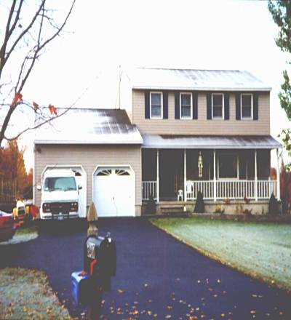
Asthmagens in the home
Air Fresheners
Cleaning Products
Sprays & Coatings
Formaldehyde
Carpets
Vinyl Floors
Drywall
Hobbies
Home Maintenance
Notes:
Volatile Organic Compounds (VOCs) is a broad class of chemicals that we breath inside our homes. It is tough to make broad generalizations – other than to say that less exposure is better.
If you want to understand whether the chemical is dangerous you need to understand the chemical’s hazards much better and the exposures involved. The risk is the exposure times the hazard.
The list above is a start on the more significant VOCs. Ask the students to identify others.

Slide 5
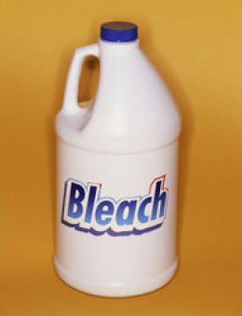
Bleach
Association of Occupational and Environmental Clinics (AOEC) 2012
Workers exposure and Asthma
Not just trigger but causes Asthma
Children at greater risk
lung development
Increases in EPA registered bleach product concentration
-Issues with dilution and exposure

Slide 6
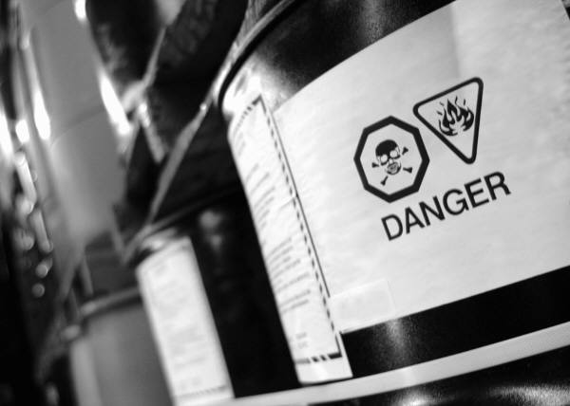



Reduce Potential Sources
Don’t use it if you don’t have to.
Use proper PPE at work or with home chores.
Substitute a better product.
Look for “Green Seal”, “Eco Logo” or “Safer Choice” on bottles.
Notes:
The same principles that were applied to the management of pests, dirt and moisture can be applied to other sources as well. First, keep it out - Don’t use it at all. Second, substitute something less likely to cause problems. Consider the risks for contaminants released by the product itself, the use and maintenance of the product, and how badly can things go wrong in the event of an accident.
Substitute with a product that has:
low VOC and particle emission
low toxicity and irritancy characteristics
low risk of chemical reactivity
low risk of fungal contamination
low maintenance requirements

Slide 7
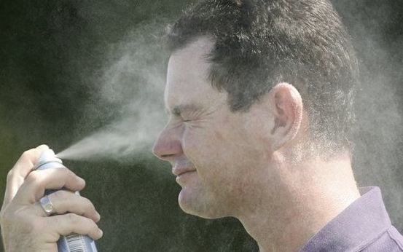


Aerosol Sprays and Fragrance
Body sprays, deodorants, cleaning sprays, and sunscreen.
Triggers asthma attacks
Why do they reach the lungs easier than sprays?

Slide 8
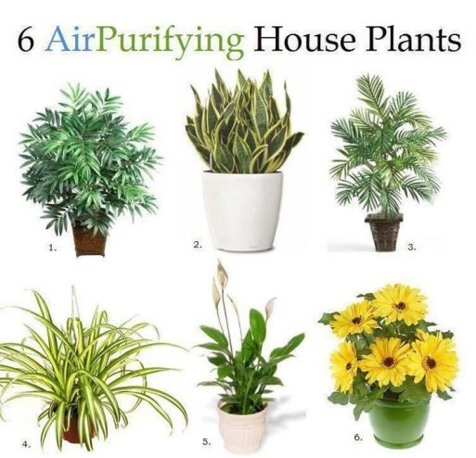
Bamboo Palm
Snake Plant
Areca Palm
Spider Plant
Peace Lily
Gerbera Daisy

Slide 9
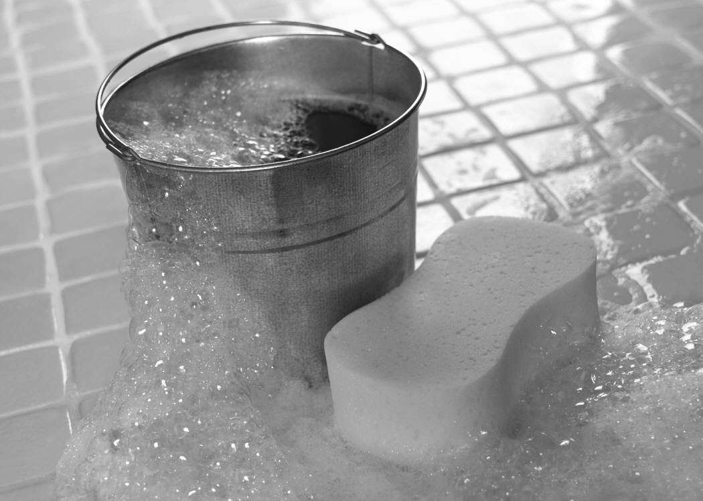
Healthy Cleaning
Don’t dry dust or dry sweep
Vacuuming:
Low-emission vacuum with beater bar
Very slowly (or use vacuum with dirt finder)
Wet cleaning:
Use “elbow grease”
Frequently change water
Use Steam Cleaners on floors and carpets
Notes:
It is best to avoid dry dusting or sweeping. You should use a damp cloth for dusting and mist the floor for broom sweeping.
When vacuuming, it is best to use a low-emission vacuum that has a beater bar and vacuum slowly.
It is often better to use wet cleaning methods than dry dusting. It is important to use good technique and “elbow grease” when wet cleaning. In fact it may be more important than what type of product you use. Make sure that you do not contaminate the wash water and frequently change the rinse water and cleaning rags.

Slide 10
Keep It Contaminant-Free – What You Can Do
Renter/Owner
Do not smoke in the house
Landlord
Use low VOC paints, carpets, adhesive and other products when renovating
Do not smoke around children
Avoid using products of high levels of VOCs
Make sure that no smoking rules are followed
Have fresh air circulating, if you use a VOC product

Slide 11
Keep It Ventilated – What You Can Do
Renter/Owner
Use exhaust fan and open windows when cleaning with chemicals or using gas heaters
Landlord
Have bathroom and kitchen exhaust fans that vent outside
Avoid aerosols and scented sprays
Use steam cleaning and DIY cleaners
Maintain furnaces
Have dryers vent outside and keep vents unclogged

Slide 12
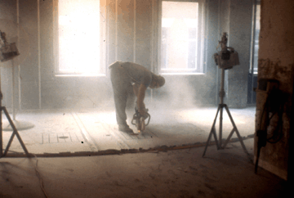
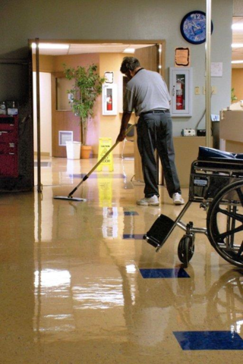
Occupational Asthma Triggers
Styrene
Sulfuric Acid
Ammonia
Bleach
Nitrogen Dioxide
Nanoparticles

Slide 13
Occupational Asthma
Questions to ask yourself:
Does asthma get worse at work or school?
Do symptoms improve when away from work?
What type of industry are you working in?
Are others at work experiencing the same issues?
When did it start?

Slide 14
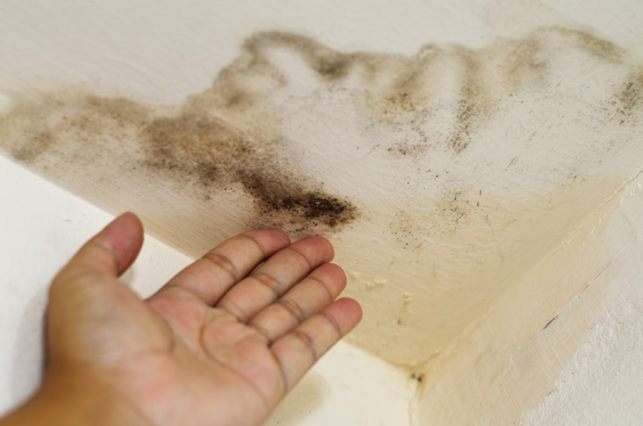
Mold

Slide 15
Moisture Sources
Poorly managed rainwater/groundwater
Plumbing leaks
Condensation on surface
Construction moisture
Notes:
Keep things dry. These are the sources of water that have to be controlled to avoid problems.
Poorly managed rainwater/groundwater
Poor roof, wall, window and foundation drainage
Defects in rain barriers
Plumbing leaks
Condensation on surface
Surfaces chilled by mechanical equipment, earth contact, outdoor air contact
Construction moisture
Concrete, wet spray cellulose, gypsum mud
Damp earth in crawlspace

Slide 16
How Water Enters a Building
Leaks
(liquid)
Cooking
Bathing
Watering Plants
Breathing
Washing
(water vapor)
Surface water
(liquid)
Air from soil
(water vapor)
Groundwater
(liquid)

Slide 17
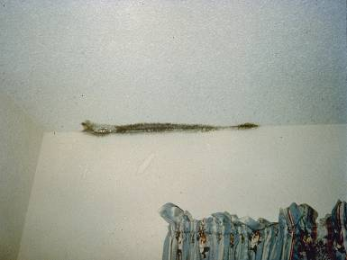
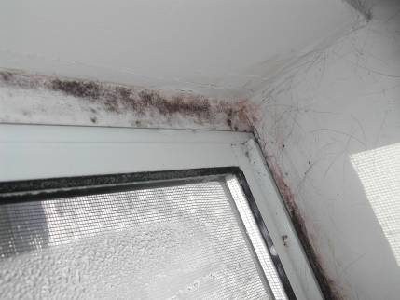
Condensation when Cold Outside
Mold around window where there is no insulation.
Mold due to poor insulation or wind blowing through insulation.
Notes:
Here is mold growing on a ceiling that is chilled by wind blowing through the soffit across un-insulated gypsum board. The second picture shows mold around a window where there is poor insulation.

Slide 18
Keep It Dry – What You Can Do
Renter/Owner
Use ventilation fans
Wipe down shower walls after use
Turn on air conditioning
Use a dehumidifier
Clean up mold
Landlord
Clean up mold
Make sure downspouts direct water away from foundations
Repair leaking roofs, walls, doors, or windows
Throw wet items away

Slide 19
Keep It Clean What You Can Do
Renter/Owner
Take shoes off at the door
Invest in a good HEPA vacuum that has a beater bar on the bottom and can be emptied quickly and thoroughly
Use plastic boxes to store clutter
Use allergen-free mattress and pillow covers for children with asthma or allergies

Slide 20
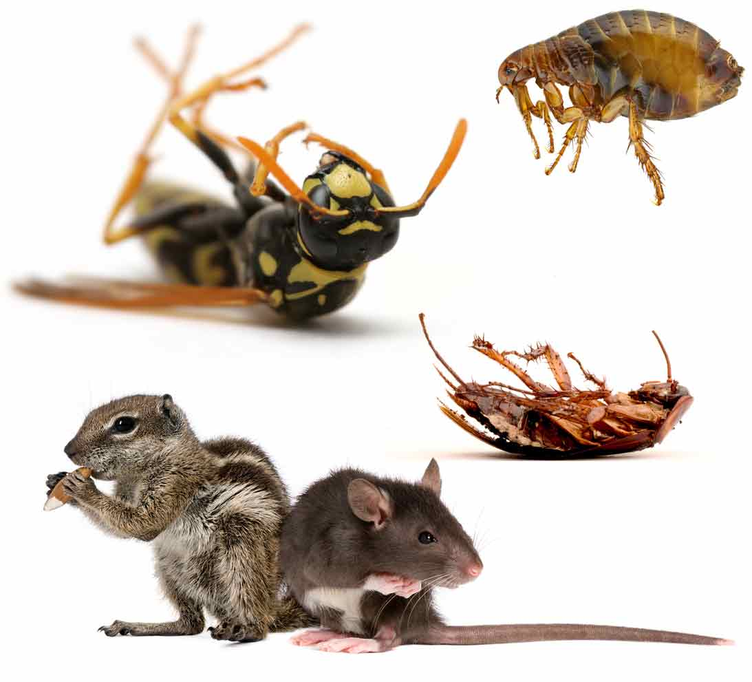
Dust Mites, Bed Bugs, and Pests

Slide 21
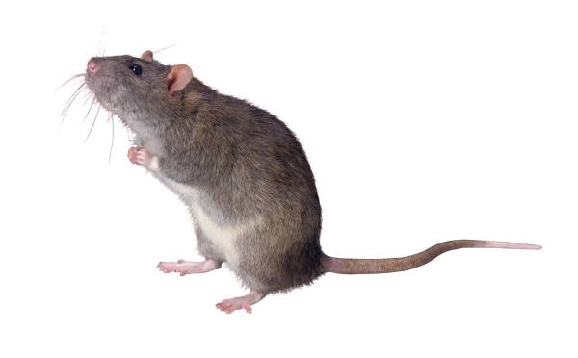
Reduce Exposure
Choose safer products
Roach baits
Gels
Dusts
Glueboards and Snap Traps
Notes:
Enclosed, tamper-proof roach baits
Baits attractive if no competing food sources
Gels applied in small dabs in cracks
Some dusts (boric acid)
Glueboards and Snap Traps
Watch for signal words on cleaning products
Choose (or make) “green” cleaners

Slide 22
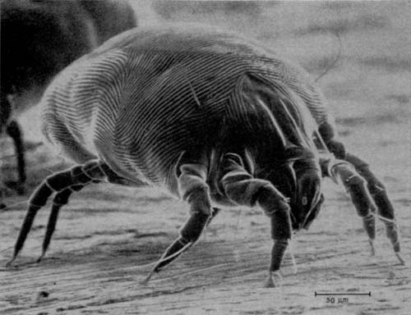
Dust mite control
Keep humidity at or below 50%
Wash bedding
Use mattress and pillow encasements
Freeze soft toys and small items
If possible, replace carpets with hard surfaces, and remove draperies and upholstery
Notes:
Dust mite control
- Keeping humidity at or below 50%
- Washing bedding and blankets
- Using dust mite mattress and pillow encasements
- Freezing soft toys and small items
If possible, replacing carpets with hard surfaces, and removing draperies and upholstery
Study published in 2003 concluded that:
Washing clothing and bedding in cold or warm water with detergent or detergent plus bleach removed most allergen and a significant (P <.05) portion of live mites. Repeated washing is required to further reduce mite levels.
Methods:
Clothing and bedding items were machine washed in 6- and 8-lb loads in warm (96.8 degrees F to 100.4 degrees F) or cold (71.6 degrees F to 80.6 degrees F) water with and without recommended concentrations of laundry detergent and sodium hypochlorite bleach. Live mites and allergen present in washed versus unwashed and washed mite-infested versus washed mite-free items were compared.
Results:
Washing clothing and bedding in water alone, detergent, or detergent plus bleach removed 60% to 83% of the live mites. Washing removed more mites from some items than from others.. Overall, 84% of Der f 1 was removed from items washed in water alone or in detergent and 98% from items washed in detergent plus bleach.
Cite: Journal of Allergy and Clinical Immunology - 2003 Jun;111(6):1269-73., Arlian LG, Vyszenski-Moher DL, Morgan MS..

Slide 23
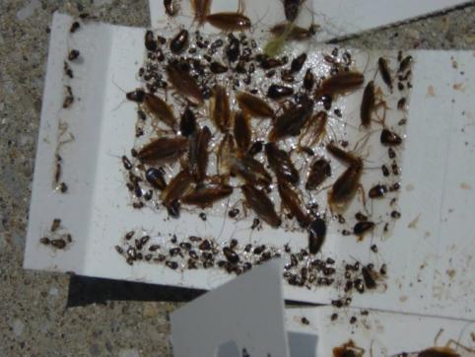
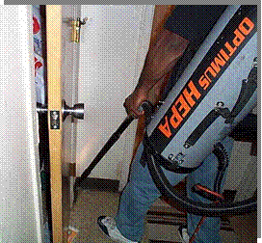
Cockroach Control
Habitat modification
Monitors
Dust and caulk
Baits and gels
Insect growth regulators
Sticky traps
Notes:
Cockroach control involves removing their food, their water, and their hiding places, as already discussed.
In addition to the dusts (boric acid and DE), caulk, glue boards, baits, gels and IGR’s already mentioned, vacuum cleaners are an excellent tool for removing large infestations immediately.
A HEPA (High Efficiency Particulate Air filter) vacuum must be used to prevent the potent cockroach allergen form being blown out of the vacuum and widely dispersed into the living space! A vacuum can suck up thousands of roaches; but - be sure to remove, double bag, and dispose it immediately to prevent infestation of the vacuum!

Slide 24
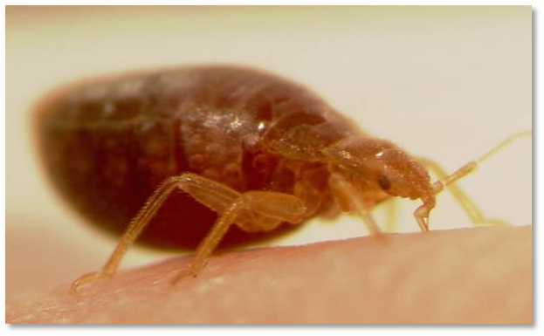
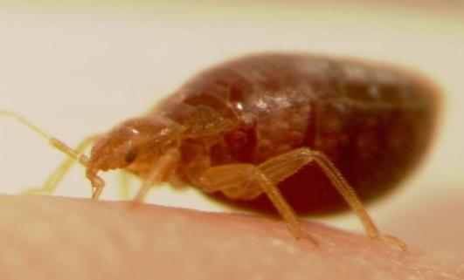
Bed bugs - Don’t Panic
Can be avoided and eliminated
Every skin irritation or bite is not bed bugs
You can see them.
Do not cause or spread diseases.
Heat and/or steam can kill them.
Protocols and communication key to control
Notes:
Bed bugs can be avoided and eliminated
Every skin irritation or bite does is not bed bugs!
You can see them.
They do not cause or spread diseases.
Simple heat and/or steam can kill them.
Protocols and communication key to control
Bed bugs are on the rise, but can be controlled – and you can avoid getting them. Also – not every skin boo-boo is a bite, and not even every bite is from a bed bug! They are not invisible – you can see them.
They do not carry or spread disease – but they are a nuisance, and can drive people literally buggy.
Although control can be challenging, as we’ll see, simple heat will kill bed bugs and their eggs.
From an agency perspective, Protocols, Cooperation and Coordination are the most important factors to prevent movement of bed bugs in multi-family housing, and between residents, and in shelters, foster care, homes and group living.

Slide 25
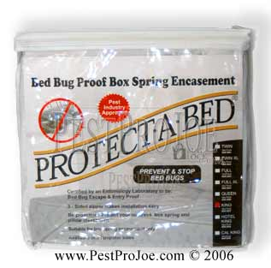
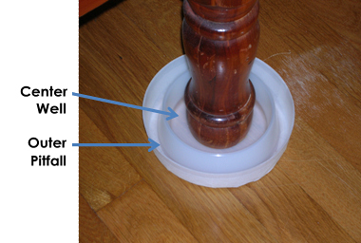
Bedbugs - Control
Exclusion
Preparation
Traps – interceptors
Notes:
Exclusion
Clutter elimination - bins
Preparation
Wash bedding
Seal mattress – encasements
NO pesticide on mattresses!
Traps – interceptors
Make the bed an island!
Monitor
Prevention
Getting rid of the bugs means getting rid of the places they hide – and this is where clutter is important. Sanitation is not an issue with bed bugs, per se, because they only feed on us, not our garbage. But clutter provides harborage; de-cluttering is a first step.
PCO’s will provide instruction for unit preparation; some residents may require assistance. Washing and dry bedding and other items on hot water settings. Use dissolvable laundry bags, or dispose of “dirty” bags and use new bags or plastic bins to return clothes to home. Don’t turn a Laundromat into a bed bug transfer station!
Mattresses should be encased, not discarded or pesticide treated! Discarded mattresses simply pass their bugs along to someone else when the mattress is picked up of the street. While a very few pesticide labels may allow application to mattresses, the PA IPM Program does not recommend this, eve, especially on children’s mattresses. The possible long term effect of sleeping on a pesticide-treated sponge has never been studied: do you want to be the test subject? Instead: use an encasement designed to stop bed bugs! Encasements are designed to prevent bedbugs from biting from, or getting out of the mattress, and prevent bed bugs from being able to live on the mattress. Use only encasements rated for bedbugs. While BB encasements will also contain dust mites and their allergens, allergen-only encasements will not stop bed bugs!
Simple interceptor traps, placed under the legs, can isolate the bed and make it a “safe island” within a still active treatment zone. (Mattress encasement must be used, and the bed must not touch the walls or any other object; bedclothes must not touch the floor!). Encasements and interceptors are also excellent prevention – they allow you to monitor for insects, and see and eliminate them before an infestation can be established.

Slide 26
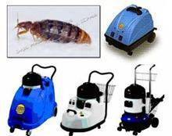
Bed bug - Treatment
Inspection
Vacuum
Heat or cold
Pesticides by PCO only
Re-inspection & retreatment
Encasements & interceptors
Notes:
Inspection
Crack & crevice:
Treatment
Vacuum
Heat or cold
Pesticides by PCO only
Dusts
Crack & crevice treatment
Re-inspection & retreatment
Encasements & interceptors
Inspection is the key to bed bug treatment and control. Bedbugs hide! Finding them is a challenge. They prefer cracks & crevices as thin as a credit card; their eggs are only 1 millimeter – 1/28th of an inch!- long. Inspection means examining and disassembling, as necessary, the bed & associated systems, bedside furniture, baseboards and carpets, and possibly closets, clothes, etc. Remember that beds are not the only place people sleep – recliners, couches, wheel chairs, and all upholstered furniture need checking. Inspection – and only inspection - guides treatment!
Vacuuming is very useful for removing lots of bugs quickly. Because the eggs are glued into remote and tiny locations, vacuuming is unlikely to remove all the eggs, and is not effective for total control, but it is very useful.
Heat – or cold – treatments are the current “gold standard.” Temperatures below freezing (32 ˚ F) or over 120˚F, for more than 20minutes will kill bedbugs and their eggs. Remember to consider insulation, and how much time you may need – but anything you can put in a hot dryer for 30 min. will be fine. Steamers are also effective, but need to be professional-grade, low pressure and low vapor; application rate is 4 feet a minute – or 1 foot every 15 seconds! BB treatment takes time, and labor; that’s why it’s expensive.
Pesticides, if necessary should be applied only by a licensed pest management professional; aerosols & foggers should never be used.
Most control requires at least 2, usually 3 treatments 2-3 weeks apart: reinspection needs to be part of every treatment plan. Follow through on decluttering, laundering, and other PMP recommendations is essential.
While reinfestation is possible at any time, encasements and interceptors are important prevention and monitoring tools and should be left in place.

Slide 27
Keep It Pest-Free What You Can Do
Renter/Owner
Do not leave dirty dishes out overnight
Landlord
Use baits, traps, or gels to kill pests
Sweep, mop, and vacuum regularly
Take garbage to the trash area at least once a week (everyday if you have pests)
Repair water leaks or damage

Slide 28
Healthy Homes Principles
1. Keep it DRY
2. Keep it CLEAN
3. Keep it PEST-FREE
4. Keep it VENTILATED
5. Keep it SAFE
6. Keep it CONTAMINANT-FREE
7. Keep it MAINTAINED
Notes:
While there is no recipe that can guarantee a healthy home, you’ll be learning about key principles that can help create healthier indoor environments. You’ll hear about these principles throughout the course of the training.
Healthy homes is a systems level approach. We have few programs that look at the whole home environment and the total needs of a family. In this training, we are introducing a new way of thinking about the home environment – an integrated approach that considers the people living in the home, the structure, and the potential health hazards. Considering health and housing problems together in a coordinated way is more efficient and prevention-effective.
“Healthy Homes” programs offer a comprehensive and coordinated approach by promoting interagency collaboration, community participation, and cross training. That is why we have convened this multi-disciplinary training. By design, we have recruited public health, housing, and environmental health professionals.
Many of the core healthy homes principles are captured in the codes and regulations designed to protect residents.

Slide 29
Resources
http://www2.epa.gov/saferchoice
http://www.greenseal.org/
http://www.turi.org/
http://www.epa.gov/asthma/
Umass Lowell Healthy Homes

